Slide 1
Sign Language Recognition
Bridging the Silence: Empowering Communication through Sign Language Recognition

Slide 2



Panimalar I nstitute Of Technology
Department of Information Technology
Submitted
By
Saran Nithish.NA (211520205131)
Sakthi Murugan.V (211520205122)
Shyam Ganesh.J (211520205138)

Slide 3
01 | Introduction
02 | Abstract
03 | Literature Survey
04 | Existing System
05 | Proposed System
06 | Architecture Diagram
07 | Software Requirements
08 | Hardware Requirements
09 | Conclusion
10 | Future Enhancement
CONTENTS

Slide 4

INTRODUCTION
Sign language is a visual language used by deaf communities around the world. It involves a combination of hand gestures, facial expressions, and body movements to convey meaning.
Sign language recognition technology aims to bridge this communication gap by enabling real-time translation of sign language into spoken or written language.This mini project report explores the use of OpenCV, MediaPipe, and Random Forest Classifier Algorithm for sign language recognition.The proposed system uses hand gesture recognition to identify and interpret sign language gestures. The system first captures video input from a camera, then processes it using OpenCV and MediaPipe to extract features from the hand gestures.
Finally, a Random Forest Classifier Algorithm is used to classify the hand gestures into their corresponding sign language meanings.

Slide 5

ABSTRACT
Sign language is a crucial means of communication for individuals with hearing impairmentsThe approach we proposed in this model employs a combination of image processing, feature extraction, and machine learning algorithms to recognize signs based on the position and movement of the hands and fingers.The proposed methodology leverages the power of machine learning and computer vision techniques to recognize and interpret sign language gestures in real- time. The system utilizes MediaPipe, an open-source library, for hand tracking and gesture recognition.This research paper presents a novel approach to sign language detection using Python, Scikit-Learn, and MediaPipe.

Slide 6
LITERATURE SURVEY
S.NO | YEAR | TITLE | AUTHOR | MERITS | DEMERITS
1 | 2023 | SIGN LANGUAGE RECOGNITION USING DEEP NEURAL NETWORK | Aakanksha Rukmana Rangdal,Sheethal Bandari | Leads to more advanced sign language communication systems. | In this model, overfitting takes place
2 | 2022 | SIGN LANGUAGE RECOGNITION USING PYTHON AND OPENCV | Dipalee Golekar,Ravindra Bula | Allows the identification of gestures better than previous systems | Limited real time performance on resource constrained devices
3 | 2022 | DEEP LEARNING FOR SIGN LANGUAGE RECOGNITION: CURRENT TECHNIQUES, BENCHMARKS, AND OPEN ISSUES | Muhammad Al- Qurishi,Thariq Khalid,Riad Souissi | These model can handle various data sources and formats, with promising results. | One of the unique limitations this model is that they lack positional information
S.NO
In this model,
overfitting takes place
1
Limitedreal time
performance on resource constrained devices
2
One of the unique
limitations this model is that they lack positional information
3

Slide 7

EXISTING SYSTEM
The system employs a combination of image and video processing algorithms to analyze hand gestures and recognize corresponding sign language symbols.It involves capturing hand movements through a camera, preprocessing the data, and applying feature extraction algorithms. The extracted features are then fed into a machine learning model, such as a convolutional neural network or a recurrent neural network, to classify the detected signs. The existing system's performance is evaluated using benchmark sign language datasets, and the results demonstrate its accuracy and efficiency. This research contributes to the advancement of technology for sign language interpretation, fostering inclusive communication and supporting the integration of individuals with hearing impairments into mainstream society.

Slide 8

PROPOSED SYSTEM
The proposed system of Sign Language Detection utilizes the
Mediapipe framework and Sci-kit libraries to develop an accurate and efficient solution for recognizing and interpreting sign language gestures.Mediapipe is an open-source framework that provides a wide range of pre-built modules for various computer vision tasks, including hand and pose tracking. The system integrates with Sci-kit, a powerful machine learning library, to train a sign language gesture classification model. Using the extracted features, the system trains a machine learning model, such as Random Forest Classifier (RFC), to classify the sign language gestures. The trained model is capable of recognizing a wide range of sign language gestures, allowing for more comprehensive communication.

Slide 9
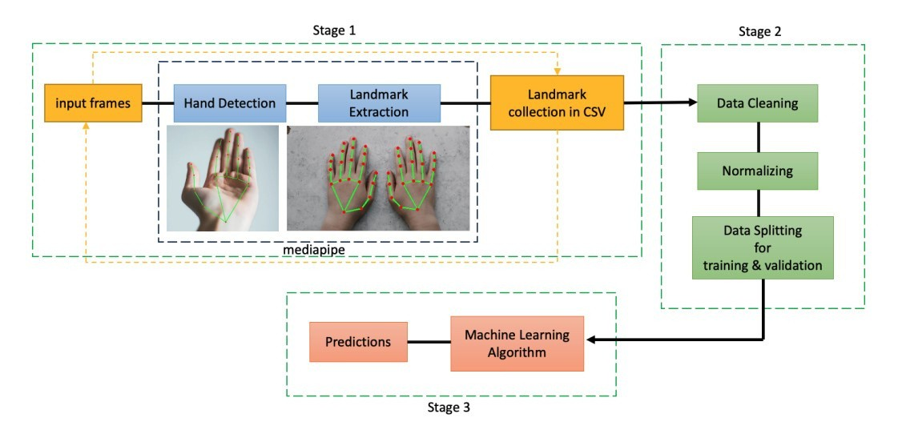
ARCHITECTURE DIAGRAM

Slide 10
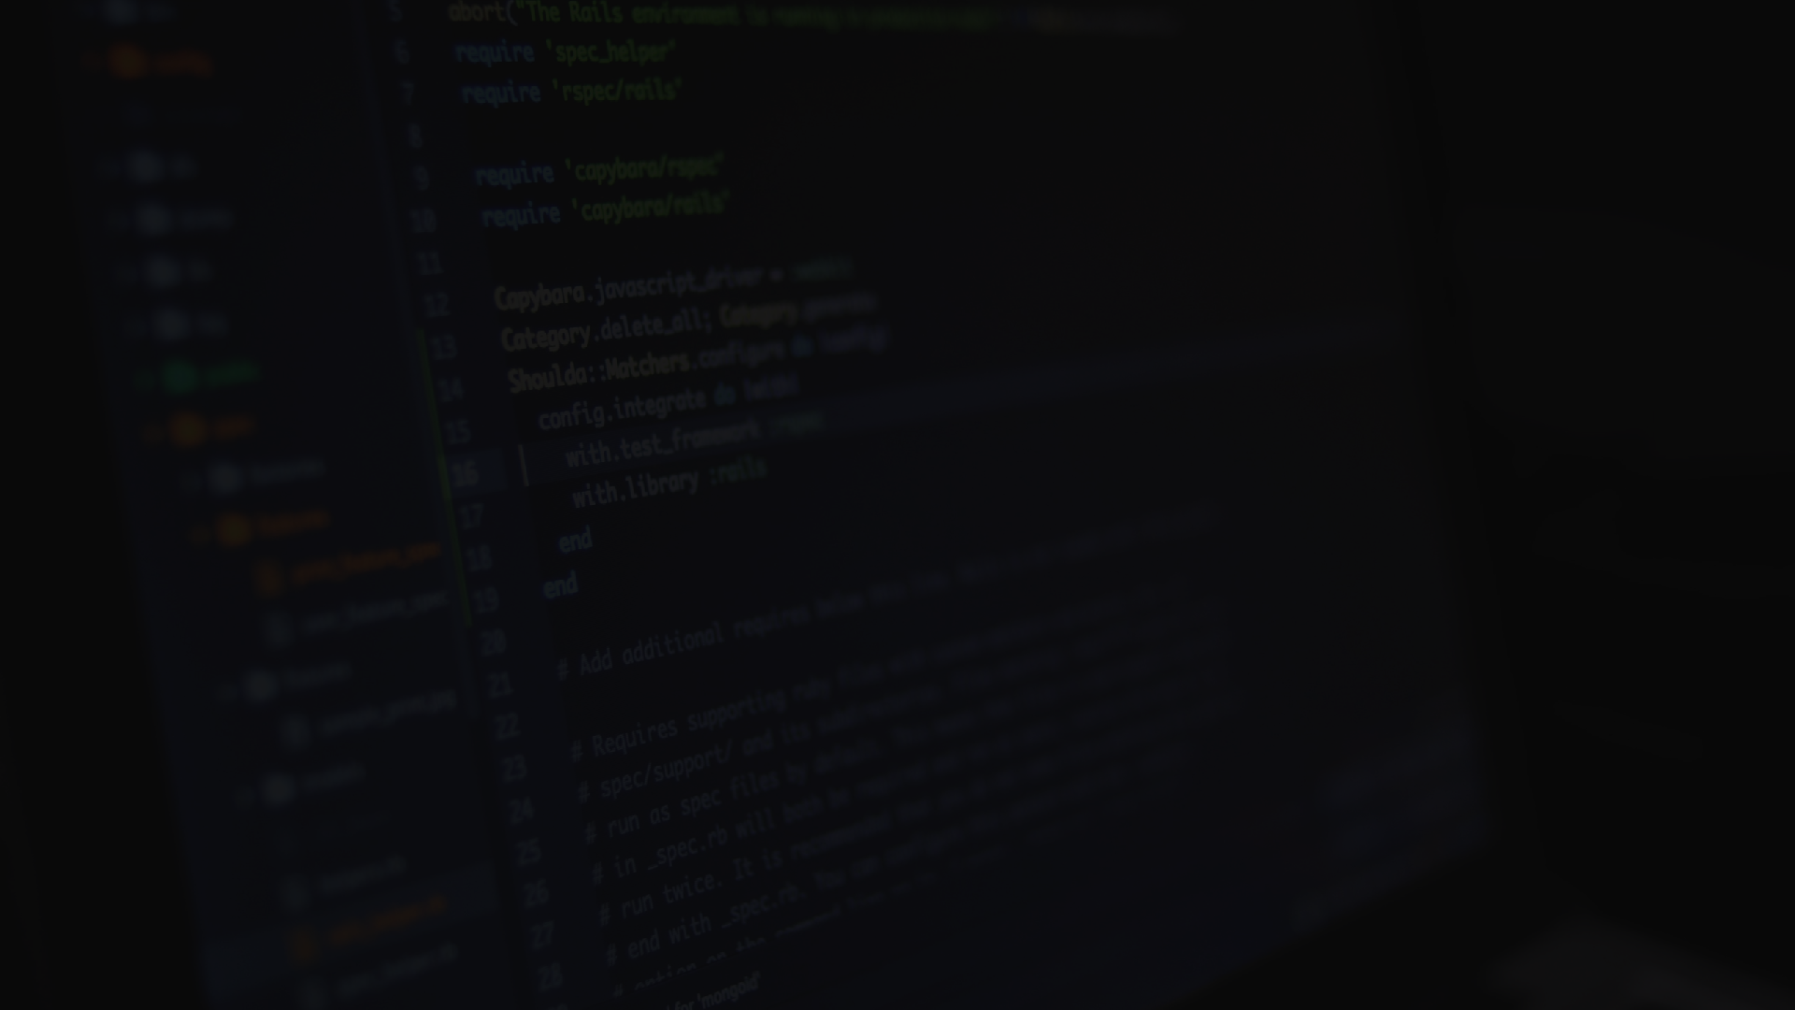

Operating System- Windows 10/11 Language-python 3.10.9 (or Higher)
SOFTWARE SPECIFICATIONS FOR SIGN LANGUAGE RECOGNITION:
Software
Requirements
Scikit-Learn (1.2.0)
Media-Pipe (0.9.0.1)
Open-CV (4.7)
VS-CODE
External Camera

Slide 11

Processor- i3,i5,i7 Speed-4.60 Ghz Ram-8gb,16gb Hard Disk-256 Gb (SSD Recommended) Graphic Card-2 Gb (Minimum)
HARDWARE SPECIFICATIONS FOR SIGN LANGUAGE RECOGNITION:
Hardware
Requirements

Slide 12

CONCLUSION
In conclusion, sign language recognition systems have emerged as powerful tools in facilitating communication and breaking barriers for the deaf and hard-of- hearing community. It is important to continue research and development in sign language recognition, focusing on improving accuracy, expanding the gesture vocabulary, and addressing the challenges posed by variations in individual signing styles and regional dialects. Furthermore, efforts should be made to enhance the accessibility and usability of sign language recognition systems, ensuring they are user-friendly, adaptable, and customizable to individual needs.Sign language recognition systems have the potential to empower the deaf and hard-of-hearing community, allowing for more seamless interaction and integration with the broader society. By enabling automatic translation of sign language into spoken or written language, these systems promote effective communication and foster inclusion.With further advancements and integration into various technological platforms, these systems have the potential to create a more inclusive and accessible society for all.

Slide 13

FUTURE ENHANCEMENT
Gesture Vocabulary Expansion: Sign language encompasses a vast vocabulary of gestures, and current sign language recognition systems typically focus on a limited set of commonly used signs. Future efforts can aim to expand the gesture vocabulary supported by these systems,enabling recognition of a broader range of sign language gestures.
Multimodel Integration: Combining sign language recognition with other modalities, such as speech recognition or facial expression analysis, can enhance the overall understanding and interpretation of sign language. Future work can explore multimodal approaches that integrate multiple sources of information to improve the accuracy and contextual understanding of sign language gestures.
Human-AI Interaction: Future research can explore the integration of sign language recognition into robotics platforms, enabling robots to understand and respond to sign language gestures effectively.

Slide 14
